Slide 1
Attrition
By Abhhay A

Slide 2
OBJECTIVE
The objective of this project is to develop a predictive model that can help identify the factors that contribute to employee attrition and help organizations retain their valuable talent. By analyzing employee data, including demographic information, job characteristics, and job satisfaction, the model aims to identify the most important factors that lead to attrition. The model will use the given data to predict the likelihood of an employee leaving the organization, and recommend actionable strategies to reduce employee turnover.

Slide 3
Business problems
This machine learning project can be helpful in solving business problems related to employee attrition. By developing a predictive model that can identify the most significant factors that lead to employee attrition, organizations can take proactive steps to retain their valuable employees, reduce turnover costs, and improve productivity.
For example, if the model finds that employees with a certain job role or level have a higher likelihood of attrition, the organization can take steps to address their concerns by offering training opportunities, mentorship, or career advancement. Similarly, if the model identifies that certain work-life balance factors, such as the number of working hours, are associated with high attrition rates, the organization can take steps to improve their employees' well-being by implementing flexible working hours, remote work policies, or wellness programs.

Slide 4
Methodology
Data Preparation: Collect and preprocess the dataset to prepare it for machine learning. This will involve removing irrelevant or redundant columns,
handling missing values, and converting categorical variables into numerical representations.
Exploratory Data Analysis: Conduct a comprehensive data exploration to gain insights into the dataset's distribution and relationships between
variables. This can involve generating visualizations and descriptive statistics to understand the data's characteristics.
Feature Selection: Identify the most critical features in the dataset that have the highest predictive power for employee attrition.
This can involve using techniques such as correlation analysis, feature importance, or recursive feature elimination.
Model Selection: Choose a set of candidate models to predict employee attrition and evaluate their performance using appropriate metrics such
as accuracy, precision, recall, and F1-score. The models can include logistic regression, decision trees, random forests, or
support vector machines.
Model Tuning: Optimize the selected models to improve their performance by fine-tuning their hyperparameters using techniques such
as grid search or randomized search.
Model Evaluation: Evaluate the final model's performance on an independent test set to assess its generalization capabilities.
This can involve comparing its performance with other

Slide 5
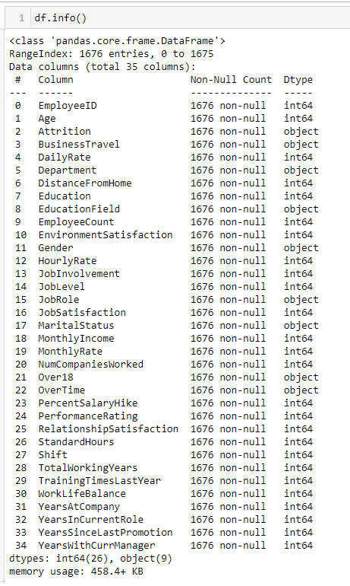

info

Slide 6
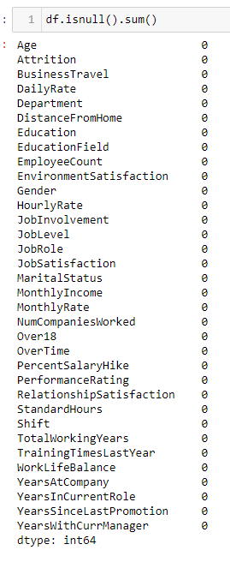
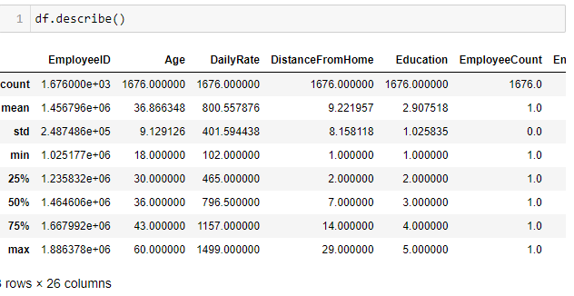

Slide 7
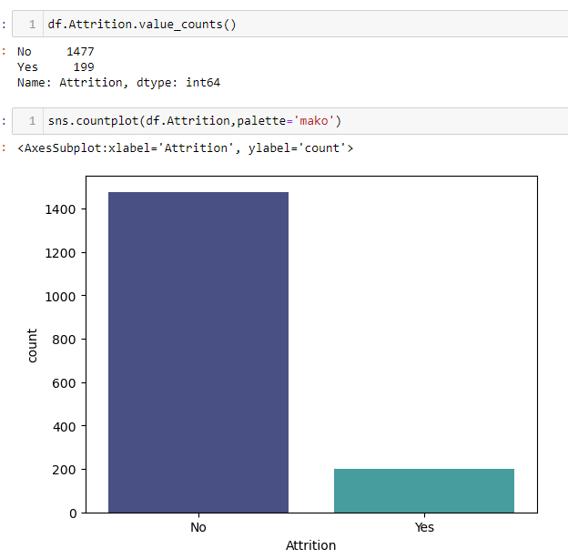
ATTRITION

Slide 8
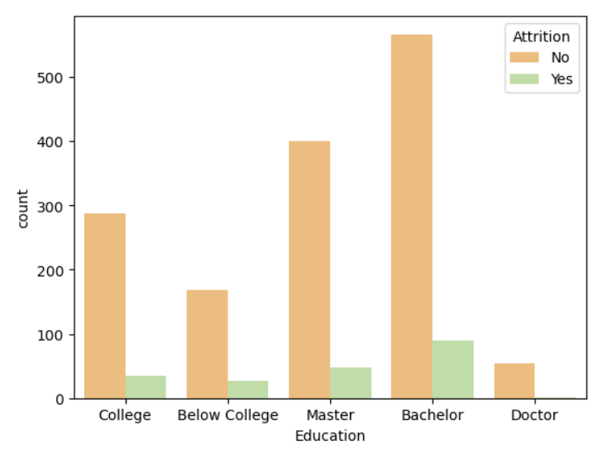
Findings From EDA
Most of the employee
has bachelors education left the company

Slide 9
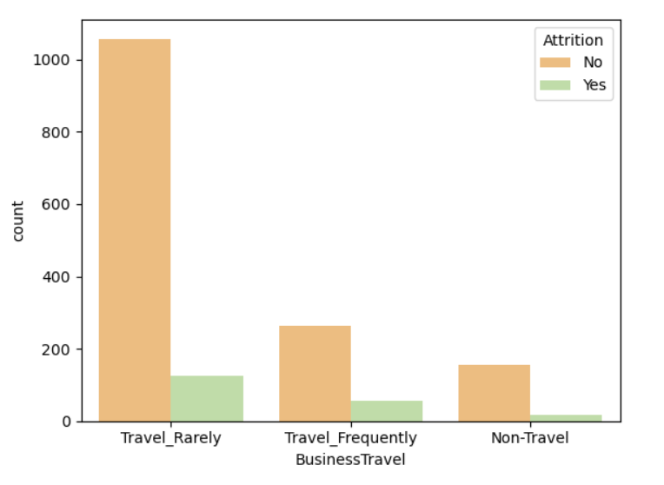
Employee travel_rarely travel left the company the most

Slide 10
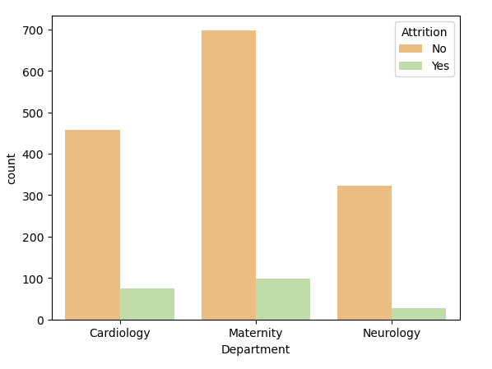
Employees who left in different depatments
'Maternity Deparment' is the department that most of the employees left

Slide 11
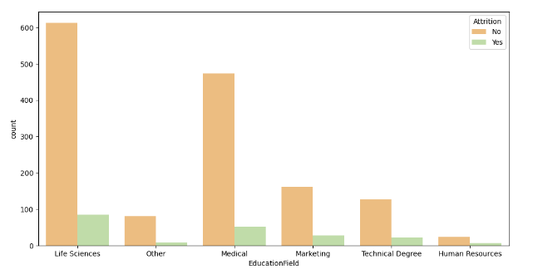
Most of the employee from 'Life Science'EducationField left the company

Slide 12
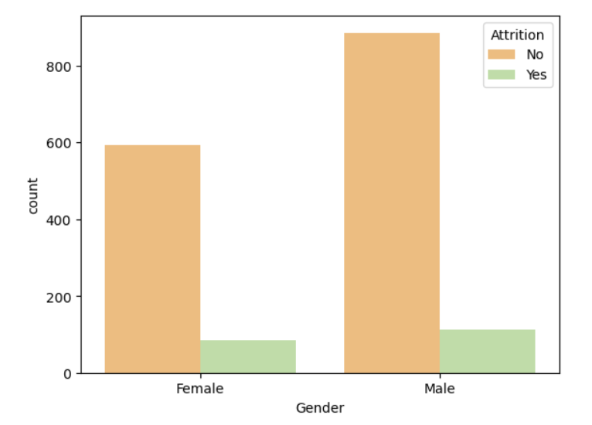
Most of the male left the company

Slide 13
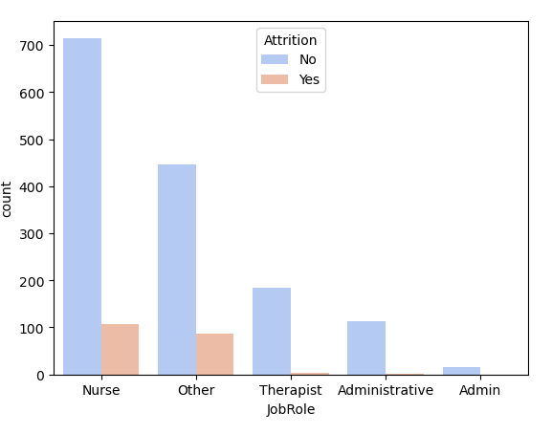
Job Role
Most of the ‘Nurse’ left the company

Slide 14
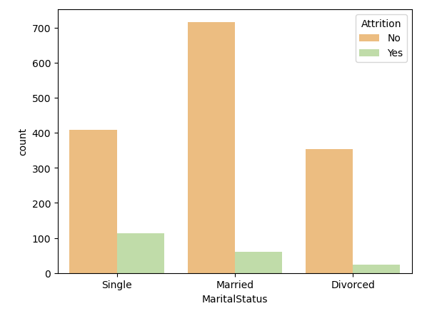
Marital Status
‘Singles’ left the company

Slide 15
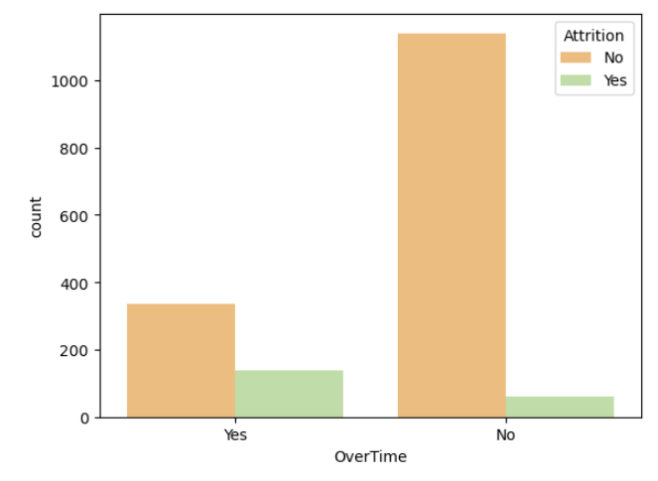
Most of the employees worked over time left the company

Slide 16
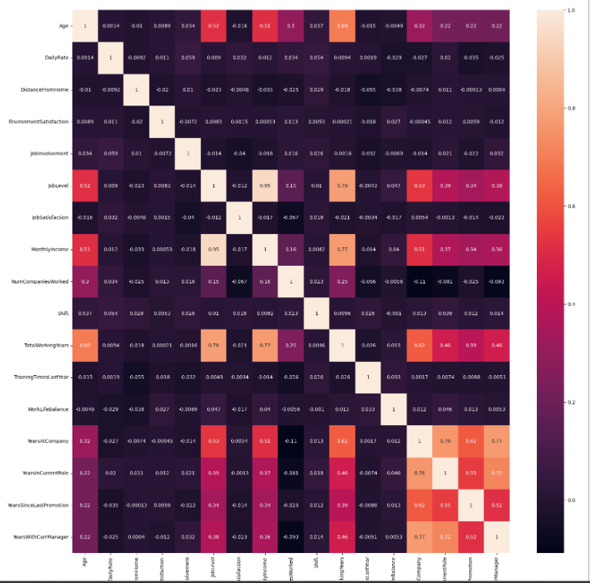
‘Year at company’ and ‘years in current role’ is correlated

Slide 17
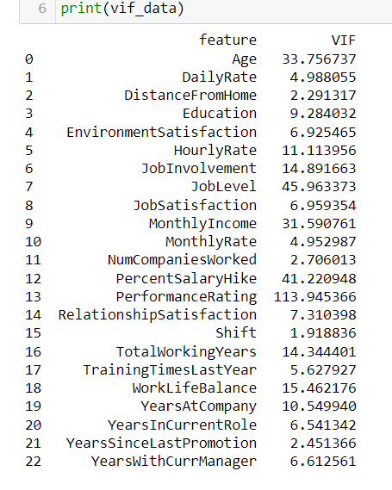
VIF

Slide 18
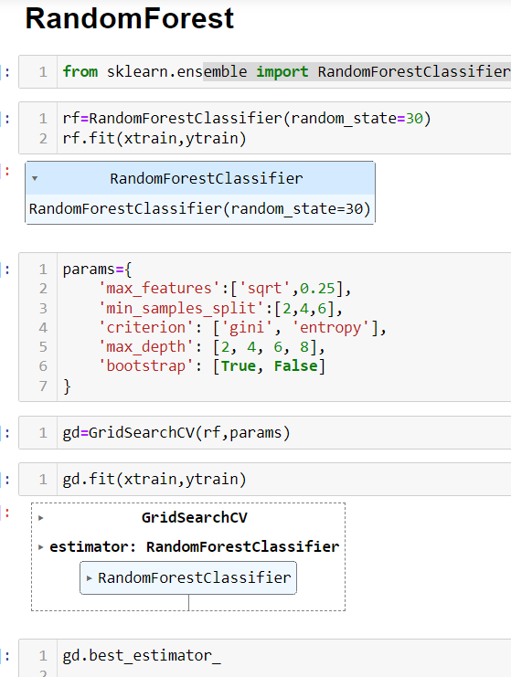
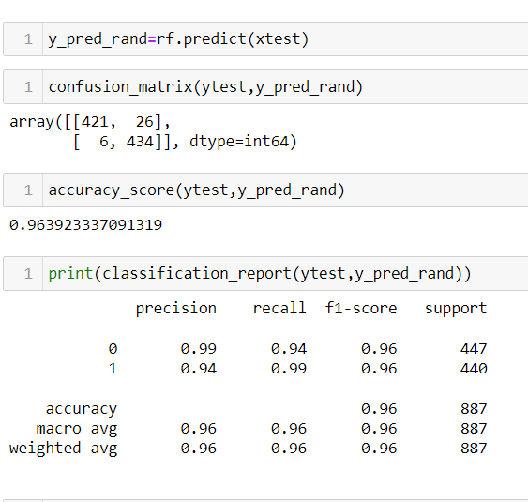

Slide 19
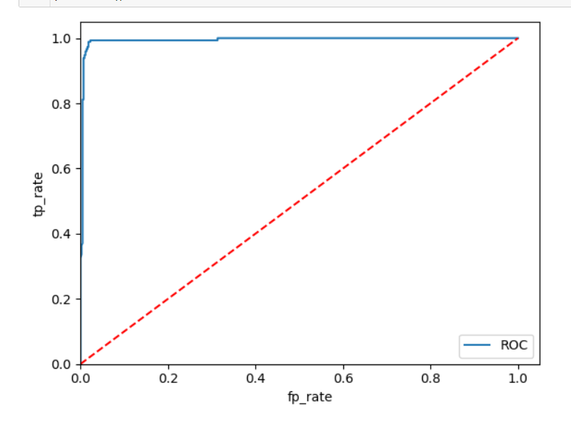
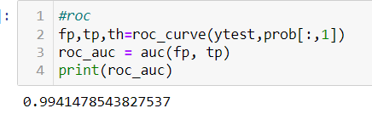
Roc curve

Slide 20
Accuracy Score
Logistic ::87
Random Forest::0.974
Decision Tree::0.940
SVM::0.651
Naive bayes::0.762
KNN ball_tree::0.917
GradientBoostingClassifier::0.974
AdaBoostClassifier::0.974

Slide 21
Conclusion
We build multiple model to evaluate and to find the best suited model to get good accuracy score and predict the target
The Random Forest,AdaBoostClassifier and GradientBoostingClassifier has the highest accuracy_score among all models. scoring 97%.

Slide 22
THE END

